Slide 1
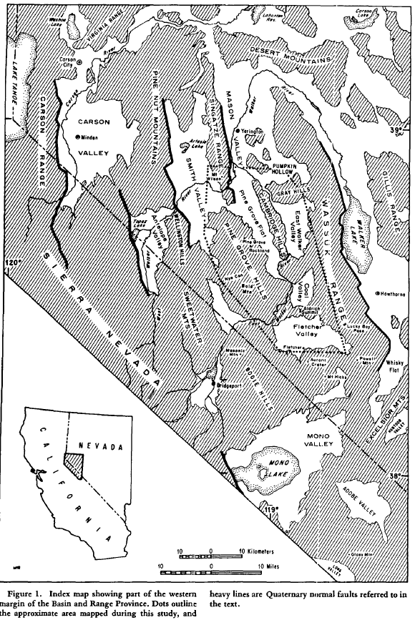
Character and Chronology of Basin Development, Western Margin of the Basin and Range Province
Gilbert 1973

Slide 2
Purpose
To define and characterize the geology and structures of six basins between Mono Lake and Yerington
Methods
Mapping at 1:62,500
K-Ar dating from 37 samples
Characterizing cross cutting relationships, marker beds, and major structures

Slide 3
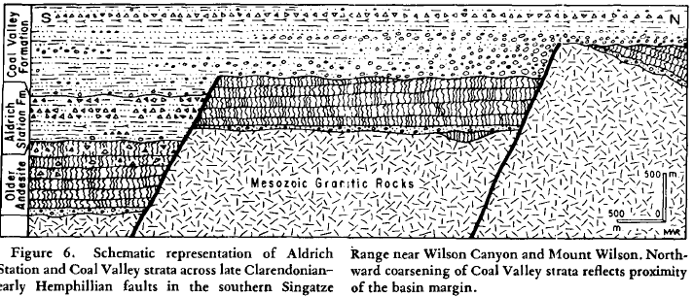
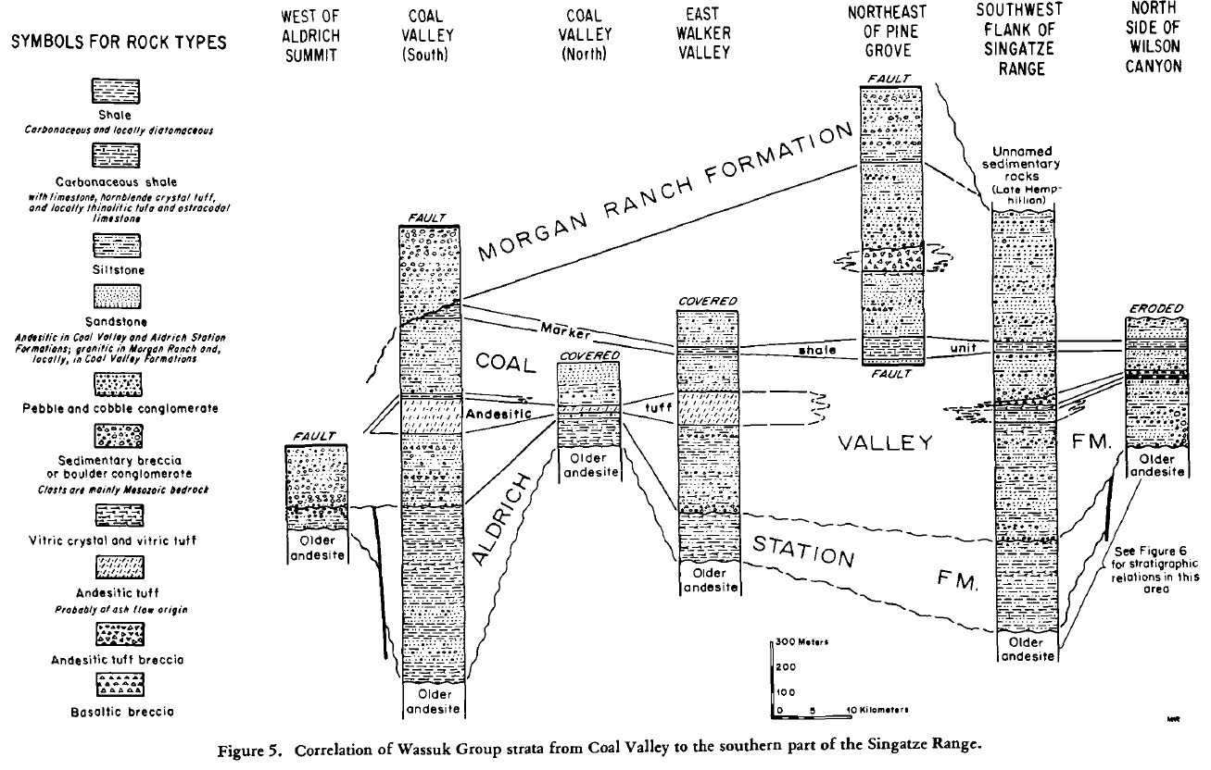
Background Geology
Basement (Mesozoic)
Granitic plutons, metavolcanics, & metasedimentary rocks of Mesozoic age
Quartz monzonite (~90-87Ma) & diorite
Metavolcanics (Triassic & Jurassic)
Metasedimentary rocks
Volcanics (Cenozoic)
Uncomformably overlie basement
Rhyolite ignimbrite (~28-25Ma)
Andesite flows & breccias (~15Ma)
Sedimentary Formations*
Lacustrine deposits of Coal Valley & Aldrich Station ~12-9Ma
“Fanglomerates of the Morgan Ranch Formation

Slide 4
Stratigraphy
Wassuk Group

Slide 5
Geology
Wassuk Group
Morgan Ranch
~15-400m of coarsening upward clastic sediments “fanglomerate”
Distinct change from tuff & andesitic sandstone of Coal Valley to sandstone & breccia (sourced from eroded basement rocks)
Coal Valley (~9-11Ma)
~50-550m thick sequence of sandstones, conglomerates, mudstones, & siltstones (lacustrine setting)
Upper reaches of the formation is marked by tuffaceous siltstone and shale beds overlain by Morgan Ranch
Base of formation marked by andesite pebble conglomerate overlying a thick sequence of mudstone beds of the Aldrich Station formation
Aldrich Station (~11-12Ma)
~300-755m thick sequence of carbonaceous mudstones, siltstones, and shales (lacustrine setting)
Andesite tuff breccia units are interbedded with these units in the upper limits of the formation

Slide 6
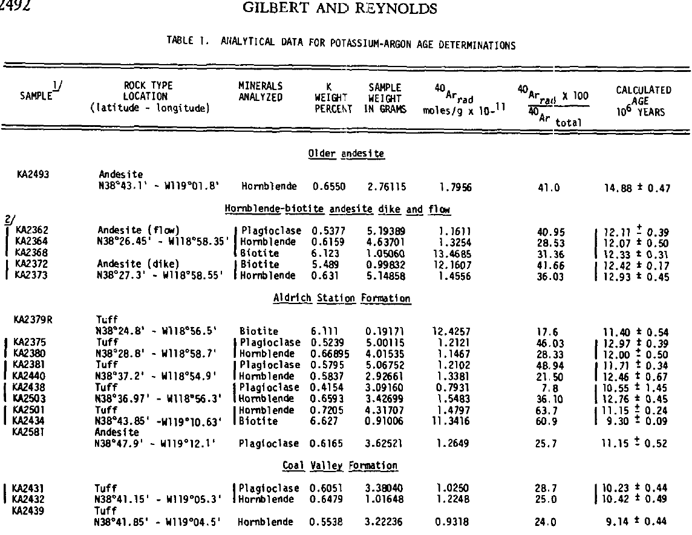
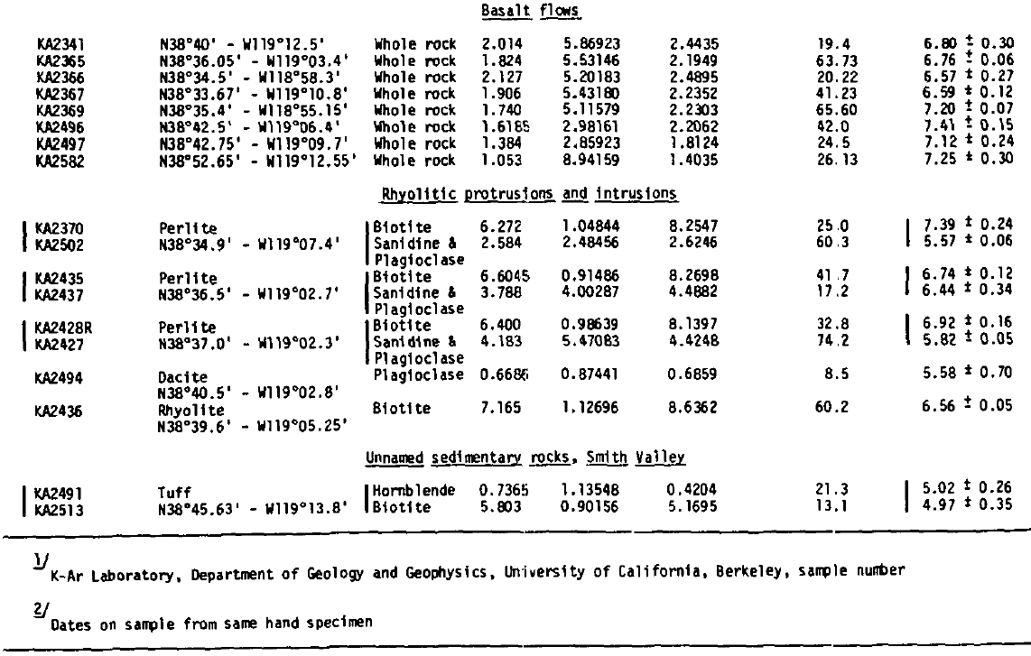
Age Dates

Slide 7
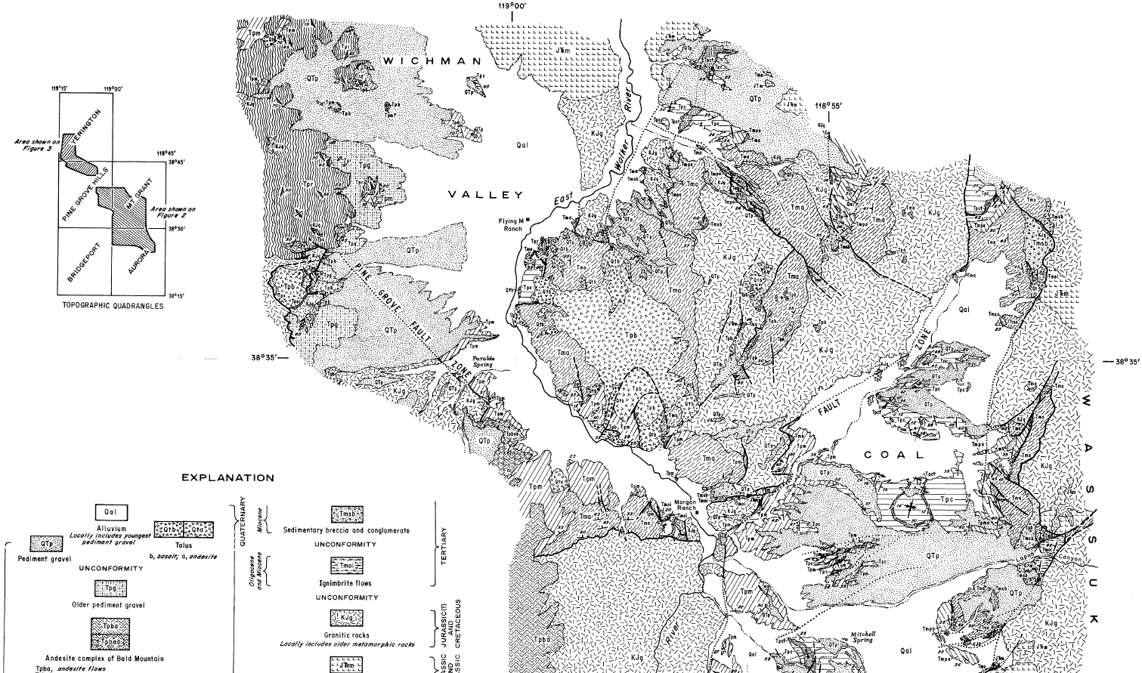
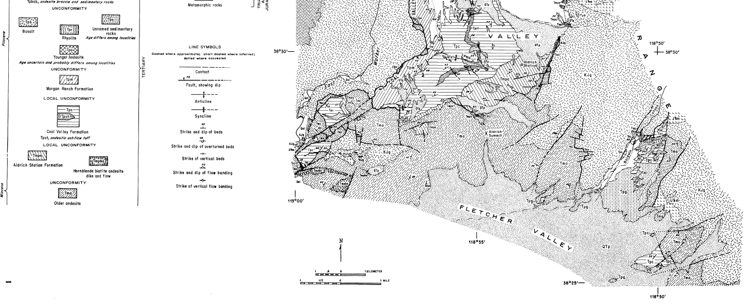
Geologic Map of the East Walker River Area

Slide 8
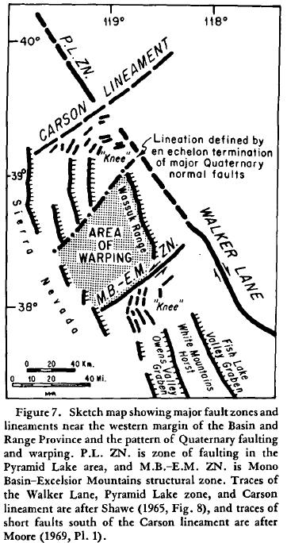
Basin & Range Deformation
Most mapped faults displace the Wassuk Group but have not been active in the last 7.5Ma. These faults dip moderately ~50-70° and trend NE
Oldest recorded deformation (~24-16Ma)
Unconformity between rhyolite ignimbrite (~24Ma) & andesite (~20Ma)
Miocene Faulting (~12.5-7.5Ma)
Faulting in Northeast trends with primarily dip-slip movement
By 7.5Ma the region had been disintegrated by normal faults into the existing structural blocks
Pliocene Faulting (4-3Ma)
Tilted fault blocks that trend North-northwest
Interval of minimal volcanic activity separates faulting events
Quaternary Faults (2.8Ma-Current)
Broad up-warping and block faulting
North-northwest trending range front faults

Slide 9
Findings
Extensive sedimentation of basins began 12.5Ma
Granitic debris along with andesitic sediments (of Coal Valley) within the Coal Valley Formation suggest basement rocks were exposed as a result of ongoing faulting suggesting progressive uplift
Faulting prior to 7.5Ma produced structurally low areas preserving Miocene-Pliocene sed. formations
Take Home Points
Faults driving the separation of structural blocks were most active between 10-8Ma
By 7.5Ma the sedimentary formations had been separated and faulting stopped
In Quaternary, warping and faulting presumed into the prominent features we see today

